Slide 1
Welcome to all
for the MHRM Online lecture
By
Dr. Dhiraj Ovhal
HOD of Commerce

Slide 2
MHRM
Online Lecture on
Marketing & Human Resource Management
Sem-5 for Marketing &
Sem-6 for Human Resource Management

Slide 3
Syllabus for Sem -5 Marketing
No | Chapter
1 | Introduction to Marketing
2 | Marketing Decision –I (Product and Price)
3 | Marketing Decision –II (Place and Promotion)
4 | Key Marketing Decision

Slide 4
Question Paper Format
All questions are compulsory Total 3 Hours & Marks 100
Q.1. Objectives as follow
A. Multiple Choice Question any 10/12 ………………..Total Mark 10
B. True /False …..any 10 / 12 ………………………………..Total Mark 10
Q.2 Write any 2 out of 3 ………from Chapter 1………………..Total Mark 15
Q.3 Write any 2 out of 3 ………from Chapter 2………………..Total Mark 15
Q.4 Write any 2 out of 3 ………from Chapter 3………………..Total Mark 15
Q.5 Write any 2 out of 3 ………from Chapter 4………………..Total Mark 15
Q. 6 Short Notes any 4 out of 6 … from all Chapters … Total Mark 20

Slide 5
Q.1 :- Meaning and Definition of Marketing and Explain the features of Marketing
Meaning:- Need identify of Customer – Right product, price, place, promotion,-Feedback-CRM- (this process is called as Marketing)
It is vital function of Business
Created demand in market as well as satisfy the customers
Definition:- Charted Institute of Marketing (UK) defines- “Marketing is the management Process of Identifying, Anticipating and Satisfying Customer requirements profitably .”

Slide 6
Features/Characteristics/ Natures/ Objectives/Essential /Elements
(Shortcut to remember ) ( P, I, C⁴ ats )
Systematic Process
1. Process- P
Continuous process
3. Ideas, Goods and Services I
4.Customer Satisfaction
5.Competitive Advantages C⁴
6.Corporate Image
7.CRM
8.All pervasive A
9.Target Market T
10.Social Interest/activities. S

Slide 7
1.Process
Systematic Process :- Need identify of Customer – Right product, price, place, promotion,-Feedback-CRM- (this process is called as Marketing
2 Continuous Process :- It starts with Market research --- Satisfy need or wants---After sales services-
continuously monitoring

Slide 8
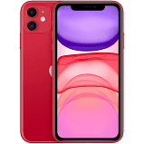
3.Ideas, Goods and Services
Goods :- Tangible things such as Mobile, Car, Soap, etc. FMCG and Consumer durable
Services :- Intangible Services such as Banking, Telecommunication, Insurance, etc.
Ideas:- Pulse polio campaign,
Blood donation, Save Girl child
Corona Virus hello tune

Slide 9
Customer Satisfaction :-
It is correlation between Customers Expectations and Product Performance
 | Product performance | Customers
1 | Product performance matches with Customer Expectation | Satisfied
2 | Product performance below than with Customer Expectation | Dissatisfied
3 | Product performance more than with Customer Expectation | Delight
4 | Product performance exceed more than with Customer Expectation | Astonished

Slide 10
5. Competitive Advantages
Effective Marketing enables to Enjoy advantages and distinct image in Competitive market to launch the new products also.
It helps to face the competition in market

Slide 11
6. Corporate Image:-
It means to enhance the reputation and goodwill in the mind of customers as well as image in the competitive market about the products and services.
XYZ Company & Tata Company

Slide 12
7. CRM:-
Now a days Holistic approach of marketing
Customer Relationship Management
Maintains Long term relationship with customers for Progress and Prosperous

Slide 13
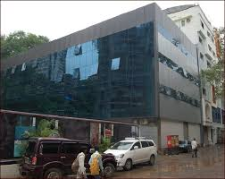
8. All pervasive:-
It is combination of “4 P”S
Product ------ TYBCOM Course
Price -------- Fee
Place ------- Tardeo
Promotion…….. Advt/ Admission Form
Example :- College/ Educational Institute

Slide 14
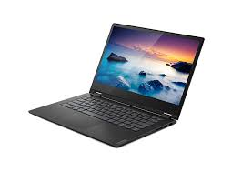
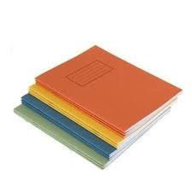
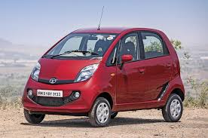
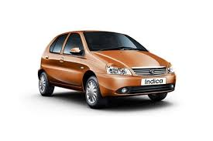
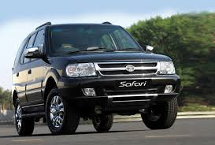
9. Target Market:- One can not sell everything to everyone.

Slide 15
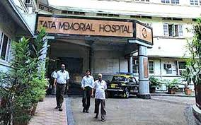
10. Social Interest/activities
Tata is selling products and services to the customers
Profits + Customer Satisfaction + Social Welfare activities

Slide 16
Features/Characteristics/ Natures/ Objectives/Essential
(Shortcut to remember ) ( P2 I, C4Ats )
Systematic Process
1. Process- P
Continuous process
3. Ideas, Goods and Services I
4.Customer Satisfaction
5.Competitive Advantages C⁴
6.Corporate Image
7.CRM
8.All pervasive A
9.Target Market T
10.Social Interest/activities. S

Slide 17
Thank You

Slide 18
Attendance Link
https://forms.gle/sTTK7ZcsHQbZv9BK9

Slide 19
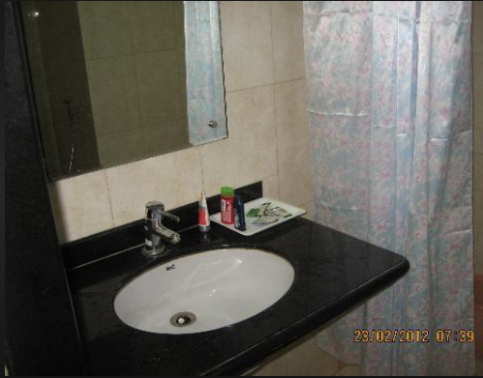

Slide 20
